Slide 1
Business Process Engineering
Sobia Iftikhar

Slide 2
Content
Business Process Improvement
How it effects on business process
Business Process Methodology
(Lean Management, Six Sigma, Agile Management, Kaizen, Total QualitY Management).
Lean Management
Six Sigma
TQM

Slide 3
What is Business Process Improvement?
Business process improvement is an exercise in which leaders use different methods to analyze their procedures.
Business process improvement (BPI) is an approach used to identify and evaluate inefficiencies within the organization.
It focus on following:
redesigns existing business tasks
improving their effectiveness
enhances the workflows
optimizes performance.

Slide 4
Business Process Improvement Steps
Step 1 – Mapping
The first step presumes the identification of the problem requiring elimination. At this point, you have to use mapping.
Step 2 – Analysis
Does our company have jobs that are taking longer than required?
In case we miss deadlines, what are the factors causing these situations?
What are the main factors influencing the inefficiencies within the organization?
Step 3 – Get Buy-In
you have to display the existing problem before the senior management. As you understand, any change requires resources. It means you have to get approval for the action plan you are going to implement
Step 4 – Implement
Step 5 – Review and Refine

Slide 5
WHAT DOES BUSINESS PROCESS IMPROVEMENT LOOK LIKE FOR YOU?
Marketing
HR
SALES
IT
Reduce the time it takes to get a campaign out the door with automated communication
Integrate your onboarding process with your HRMS to reduce manual data transfers
Add in conditional steps to get approvals for large orders over a certain value
Improve response time to service requests by auto-assigning tickets to specialists
BPI aims to pinpoint the skills or processes that need improvement in ensuring smooth procedures, efficient workflow, and business expansion

Slide 6
BPI Methodologies
Challenges are common in BPI activities.
t’s possible that there will be a breakdown in communication strategies across the organization, that work teams will be opposed to change, and that planned improvements that are not consistent with business objectives will be avoided.
Sometimes there may be a failure to communicate plans across the organization
work teams may be resistant to change,
avoiding scheduled improvements that are not in line with the business goals.

Slide 7
BPI Methodologies
Implementing these following methodologies can help organizations overcome previous mentioned obstacles. The common BPI methodologies include:
Lean management
Six sigma
Agile management
Kaizen
Total quality management

Slide 8
Lean Management
Lean Management: Lean Management is a unique approach to identify waste. It involves employees and relies on continuous improvement to maximize customer value and minimize waste.
The main purpose of lean management is to reduce factors that waste time, effort or money. The only way to manage with it is to analyze a business process and then revise it and cut out every step that does not create value for customers

Slide 9
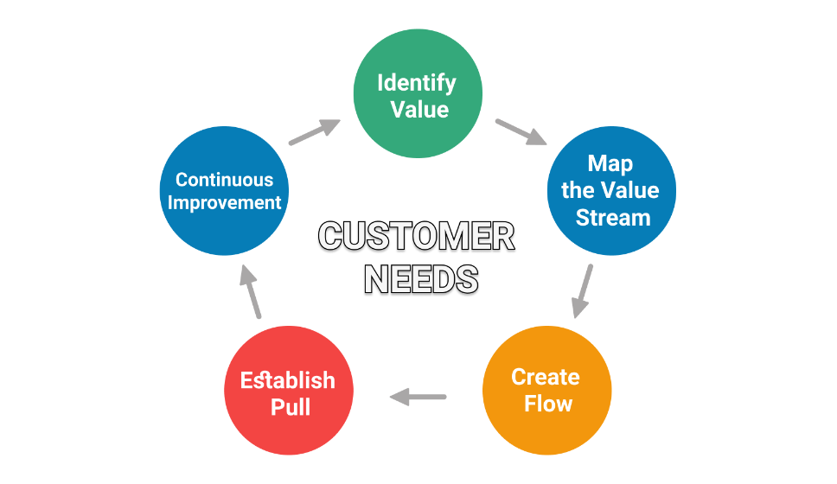
Lean Principles
Lean management principles include:
Defining value from the standpoint of the end customer.
Identifying each step in a business process and eliminating those steps that do not create value.
Making the value-creating steps occur in a tight sequence.
A pull system is characterized by work entering the workflow only when there is a demand for it
Repeating the first three steps on a continuous basis until all waste has been eliminated.

Slide 10
The Plan, Do, Check, Act methodology
Also known as the Deming Cycle, the Plan-Do-Check-Act cycle is a key instrument of the lean manufacturing toolkit.
1. Plan
What is the core problem that needs solving?
What resources do we need?
What resources do we have?
What is the best solution for fixing the problem with the available resources?
2. Do
Apply what was considered at the planning stage and put things into action
3. Check
Audit your plan’s execution and see if your initial plan worked. It will become clear what the more problematic parts of the process are, which can be eliminated later down the line.
4. Act
If things didn’t go so well, you’ll need to begin the cycle again

Slide 11
Identify the value
Value is every thing, that your customer is willing to pay.
Identify Waste Activities and Where Value Is Added
seven types of waste: TIMWOOD
Transport
Inventory
Motion
Waiting
Overproduction
Over-processing
Defects

Slide 12
3M Waste are:
MUDA means Waste
MURA means Inconsistency/Unevenness/Imbalance
MURI means Strain/Overburden/Fatigue

Slide 13
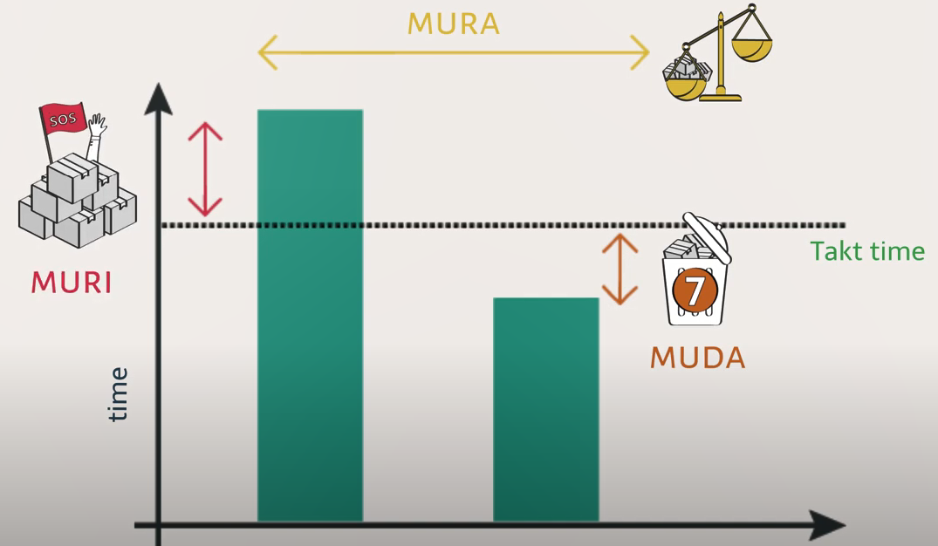
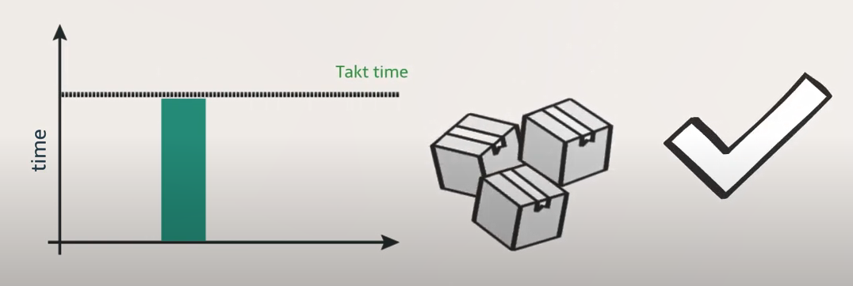
The Three waste Aspects

Slide 14
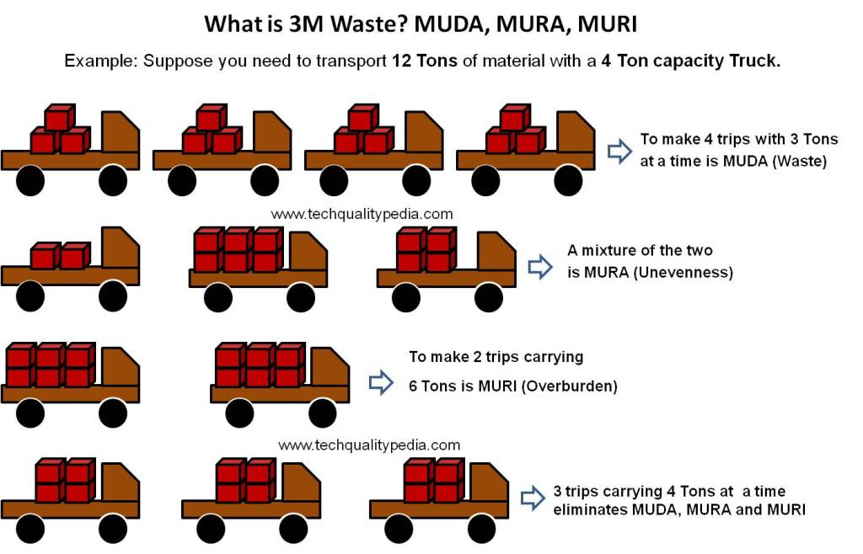

Slide 15
MUDA means Waste
MUDA stands for eliminating waste or non-value-added activities from the manufacturing process. It can be anything that does not add value from the customer’s point of view.
There are 7 types of MUDA or 7 types of Waste identified in the lean manufacturing process which is as follow:
MUDA of Overproduction
MUDA of Process Itself/Over Processing
MUDA of Inventory/Stocks
MUDA of Transport
MUDA of Waiting
MUDA of Motion
MUDA of Defects

Slide 16
Seven types of Muda or 7 types of Waste are:
SNO | Factor | Example
01 | Overproduction | occurs when items are manufactured before they are required.
02 | Over Processing | occurs when more work is put into a product or service than is actually required.
03 | Inventory | Inventory is important, but storing too many or too few supplies and finished goods increases costs and can take valuable space.
04 | Transport | Transportation is the movement of products and supplies from one area to another.
05 | Waiting | Waiting is when work or projects come to a halt or slow because machines have yet to finish producing the required goods, products have not arrived, or some other task is holding up the rest of the project.
06 | Motion | Motion is the physical movement of a person or machine required to complete work.
07 | Defects | Defects occur when errors and rework are created because of your processes.

Slide 17
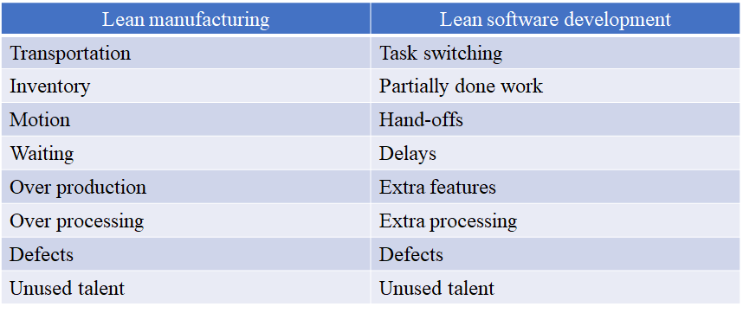
Example
The Wastes In Lean Software Development

Slide 18
Map the value stream
"Value stream mapping is a Lean management method that allows you to visualize, analyze and improve all the steps in a product delivery process."
Even individual contributors can have a bird’s eye overview of how the team’s work is progressing.
Kanban is probably one of the most reliable value stream mapping tools

Slide 19
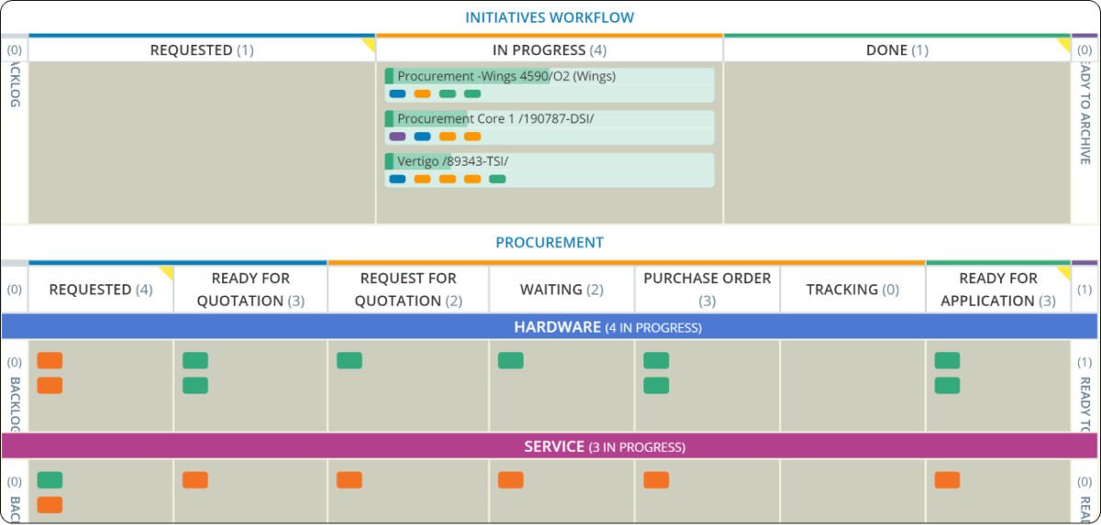
Value stream mapping
Choose a Kanban Board
Define VSM Purpose and Expectations
Visualize the Key Stages of Your Workflow
Perform Value Stream Map Analysis

Slide 20
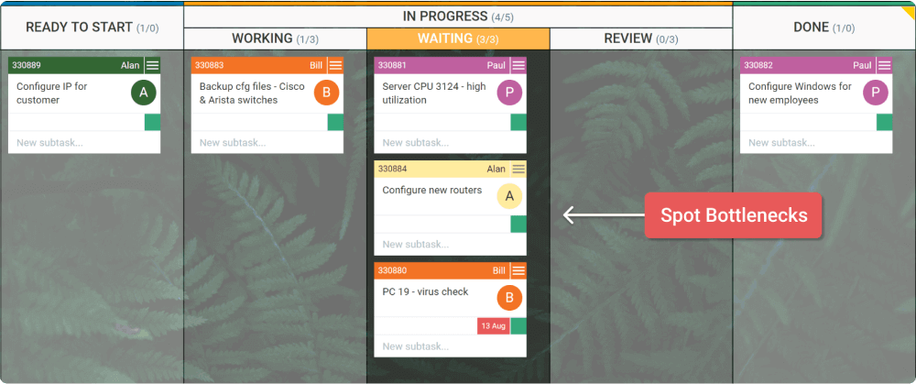
Create flow
Having removed all these, your process will be stable and will allow you to use the project resources more efficiently
Identify steps that do not create value and if you can, eliminate them. If you can’t eliminate, improve them. Make the value-creating steps

Slide 21
Create Pull System
A pull system is a Lean technique for reducing the waste of any production process. Applying a pull system allows you to start new work only when there is customer demand for it. This allows you to reduce overhead and optimize storage costs.
a work item has to be in progress only if there is a demand for it.
Example:
Apple is one of the brightest examples of how a pull system can be successful. Have you ever seen these long waiting queues in front of the Apple stores during the iPhone's latest release?
Apple always creates a buzz around their new products, and consumers are always ready to buy. They want to pull the product from the stores.
Apple doesn’t overstock their shops or retail partners. They wait to see if there is a demand for more, and if it increases, they produce more. This way, the company optimizes its resources and achieves high-cost efficiency.

Slide 22
Example -01
Truck Manufacturing
Dakota Bodies in South Dakota builds truck bodies for the service and industrial markets. To keep up with market demands, a lean team was established to work with company leaders to define their goals for the lean program. Lean 101 training was provided for supervisors, managers, and key operators. A Kanban system was installed to support just-in-time manufacturing and reduce inventory levels. Results: Revenues improved by 20 percent and with an overall increase in productivity of 5 percent.

Slide 23
Example 02
A printing company was struggling with late orders and long lead times. Inventory piled up in its warehouse, with more than 10 percent of the finished product being thrown away. To improve efficiency, a lean team was assembled to map the value stream and identify waste that could be removed from the workflow. 5S (visual workplace) was also used to maximize workflow before deploying cellular manufacturing systems. Results: On-time delivery increased to 95 percent with much-shortened lead times; improved inventory management resulted in less waste of finished product

Slide 24
Example
TOYOTA
The automobile giant was perhaps the first major company to adopt this lean ideology in their manufacturing processes, initially calling the method the Toyota Production System. Not only have they eliminated waste but they have also mastered the techniques required to minimize faulty products that do not meet customer needs. Toyota works with two primary processes that allow these goals to be reached. The first is a process called Jidoka, which translates roughly to “mechanization with the help of humans.” This means that although some aspects of the job are automated, humans are continually checking the quality of the product. There are also programs built into the system that allows the machines to shut themselves down if someone spots a problem. The second part is known as the Just In Time or JIT model. This ensures that the next step of a process is only started once the previous phase is completed. This way, if there is a flaw in the assembly line, no extra and unnecessary work will be completed. This lean manufacturing technique has paved the way for dozens of other companies to follow in their footsteps.

Slide 25
Six Sigma
Six Sigma measures inconsistencies or defects in a process.
The methodology focuses on perfecting the end product.
Experts refer to a Six Sigma Process as a process that doesn’t produce more than three defects out of a million output.
DMAIC is a core tool under the Six Sigma and consists of five parts that include:
Define: Seek out areas where you can improve.
Measure: Determine the metrics you’ll use to benchmark new processes
Analyze: Check for any inconsistencies or defects in the process
Improve: Remove the aforementioned problems
Control

Slide 26
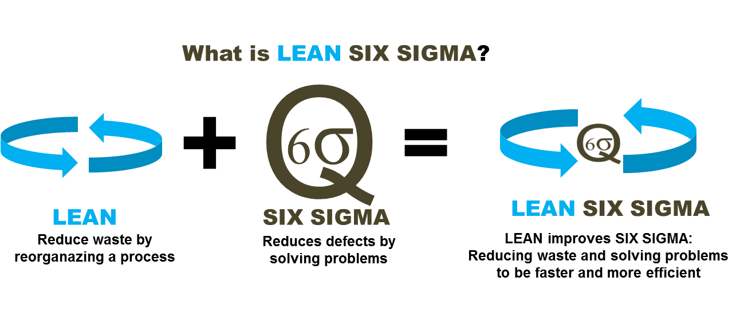

Slide 27
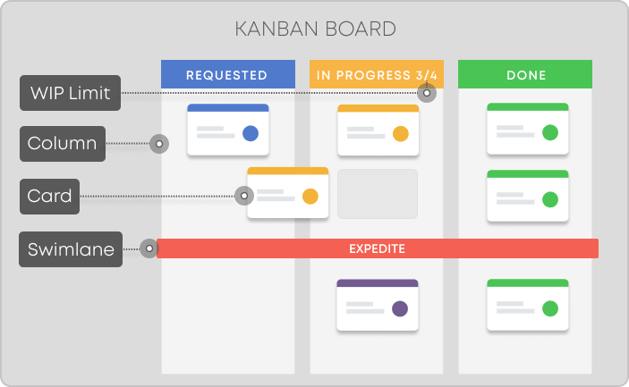
What Are the Lean Six Sigma Techniques?
Kanban approach
Kaizen
Value stream mapping
5S model
Everyone Speaks the Same Language
Creates a Growth Mindset
Increases Motivation
Better Acceptance of New Ideas

Slide 28
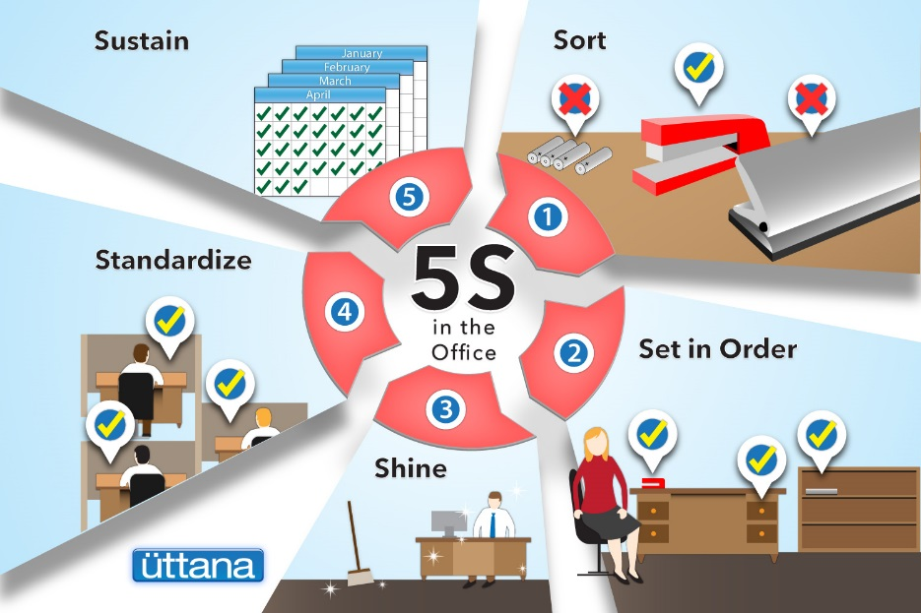
5s of lean
One of the most popular Lean tool. 5S is a system for organizing spaces so work can be performed efficiently, effectively, and safely. This system focuses on putting everything where it belongs and keeping the workplace clean, which makes it easier for people to do their jobs without wasting time or risking injury.

Slide 29
TQM
Total Quality Management (TQM) is a methodology that originated in the 1950s, but only becoming popular in the early 1980s.
As with the Lean methodology, it’s main priority is delivering value to the end-customer. The difference is, however, that TQM focuses on the organization as a whole, rather than individual processes. The key idea here is that every department (anything from engineering to marketing) within the company should be optimized with customer values in mind.
What really makes TQM shine, however, is that it involves the alignment of an entire organization. It’s not just the responsibility of the senior management to carry out change – rather, it’s a company-wide initiative, all the way down to the lowest level employees.

Slide 30
Total Quality Management Tools
Total quality management relies on what is known as the Seven Quality Tools, a set of charting and graphing techniques to help identify quality issues. The tools used in TQM are:
Fishbone Diagram / Ishikawa Chart: Used to visualize cause and effect and identify the root cause.
Check Sheet Template: Used to collect data in real time.
Control Chart: Used to check if the process is in a state of control.
Histogram: Used to estimate probability distribution based on values within a certain range.
Pareto Chart: Used to evaluate the defects that are frequently occurring and assessing them by category.
Scatter Diagram: Used to represent two values in a set of data.
Stratification Diagram: Also called a flow diagram or a run diagram, stratification diagrams are used to sample a group.

Slide 32
Major roadblocks that can influence a company’s work processes negatively:
There are three types of waste in Lean:
Muda (wasteful activities)
Muri (overburden)
Mura (unevenness).

Slide 33
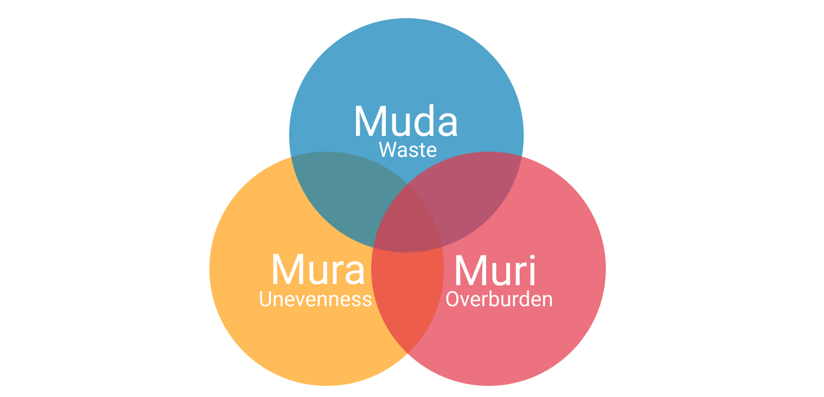
Assignment

